Slide 1

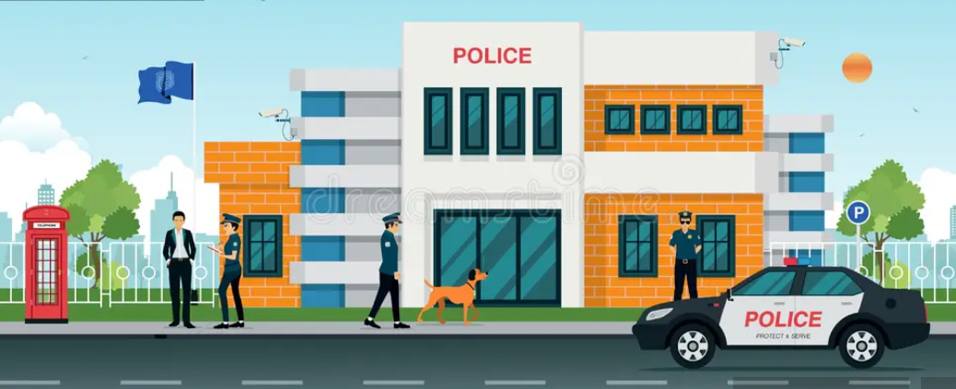
Crime Data Analysis (Chicago - 2022)
Presented by Roshni Kumari

Slide 2
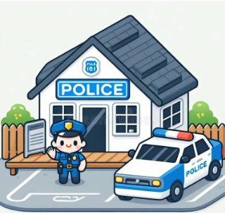
Introduction
Objectives and Problem Statement
Did you know that certain Chicago neighborhoods reported a crime every few minutes in early 2022?
In response, the government launched a high-impact operation deploying top-performing officers to curb the surge. One year later, it's time to measure the impact.
This project aims to:
Evaluate whether the average case-solving time has improved.
Identify neighborhoods with consistently high crime rates.
Recommend actionable strategies to further reduce crime.
Using comprehensive data from 2022, this analysis will uncover key trends and offer data-driven insights to support smarter policing and safer communities.

Slide 3







Data overview
Key Stats
Total Cases Analyzed: 90,865
Duration Covered: 1 Year
Average Resolution Time: 6.98 Days.
Total ward
Total crime types
Columns Date, Block, IUCR, Type, Description
Location Description, Arrest, Domestic
Beat, District, Ward, Community Area
FBI Code, Coordinates, Year, Location
Total district
Average resolution time
Data Structure
Total case number
Most Reported Crime
Dataset Summary| Columns Included

Slide 4



Methodology
Removed duplicate entries and blank rows to clean the dataset
Utilized DAX functions to create measures and calculated columns for data summarization
Used tables and matrix visualizations to present detailed data insights
Implemented multiple charts, slicers, and filters to perform deep-dive analysis and identify key factors
Designed three interactive dashboards using bookmarks and buttons for enhanced user experience:
Main Dashboard Tab
Domestic Tab
Location Tab

Slide 5

INSIGHTS – MY FINDINGS

Slide 6
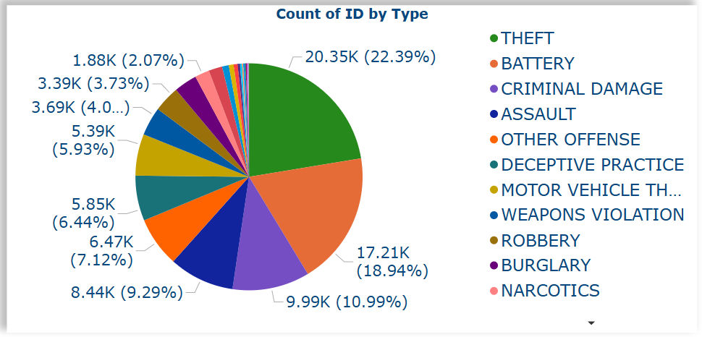
Total crimes by crime type
Crime Statistics Highlights
✔ THEFT dominates
20,350 cases (22.4%) - #1 offense
✔ BATTERY ranks second
17,210 cases (18.9%) - Critical focus area
✔ Top 3 crimes = 52% total
THEFT + BATTERY + CRIM DAMAGE = 52.3%

Slide 7
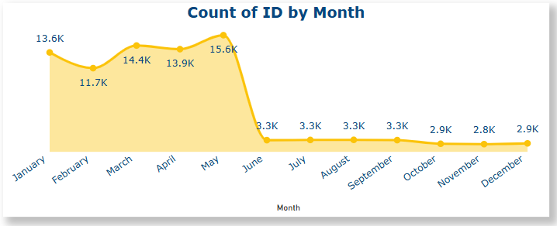
Seasonal Crime Trends in Chicago (2022)
1. Peak Crime Period: January–May
15.6K cases in April (Highest monthly volume)
Consistent high activity (>13K/month) pre-intervention
2. Sharp Decline from June Onward
~67% drop post-May (15.6K → Avg - 3K/month)
Stabilized at <3K cases/month (June–December)
3. Government Action & Proven Impact
May 2022: Special police operation deployed
Targeted patrols and community engagement programs
Result: Sustained reduction through year-end

Slide 8

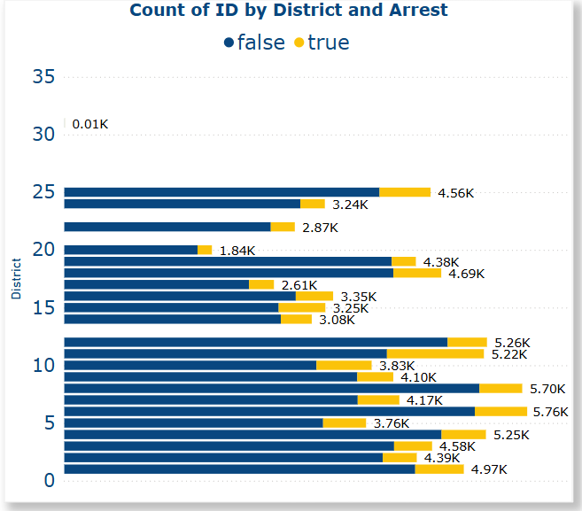
Arrests by District – Key Insights
District 11 has the highest number of arrests (1207).
District 20 has the lowest number of arrests (179).
Districts 20 & 22 have relatively low arrests despite notable total crime counts.
Districts 10, 25, and 1 also show high arrest counts (above 600).
Emphasizes uneven enforcement across districts, suggesting the need for standardized policing efforts.

Slide 9
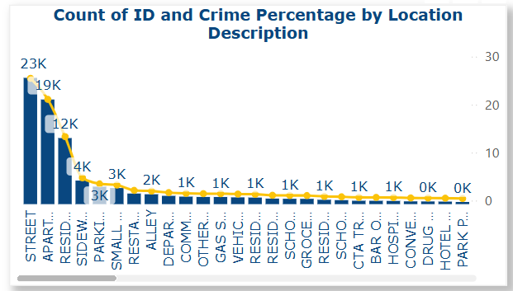
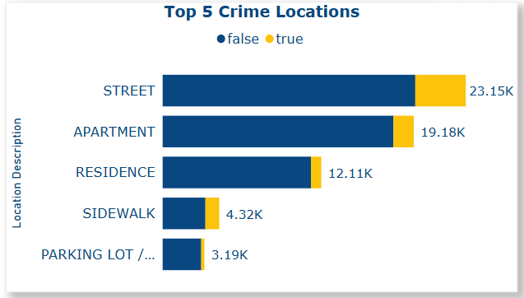
Crime Hotspots by Location
🔴 Street crimes are increasing noticeably, raising public safety concerns.
🏢 Apartments 2nd highest incidents + Residences = 30% total
🚨 Sidewalks(4th) | Alleys(7th) (Poor lighting/visibility hotspots)
Parking Lots (Low-security targets)
✅ Secure Locations
• Schools/Hospitals (High traffic, low crime)
• Banks/Govt Buildings (Security works)

Slide 10
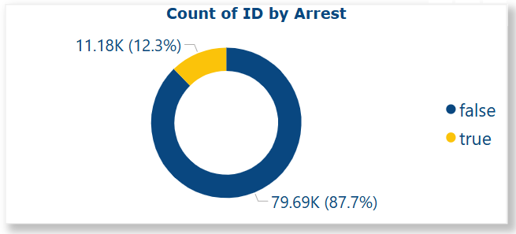
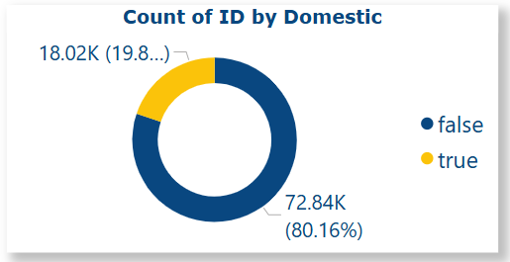
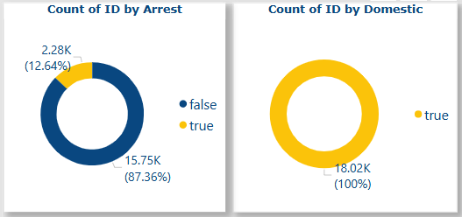
Domestic Crime & Arrest Analysis
19.8% of total crimes are domestic-related (18.02K out of 90.86K).
Only 12.3% of total crimes result in an arrest.
Among domestic cases, just 12.64% lead to arrest.
87%+ of both total and domestic crimes end without arrest.
Highlights a need for improved enforcement in domestic cases.

Slide 11
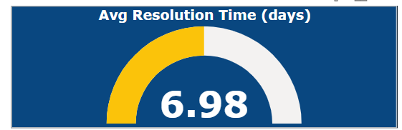
Case Resolution Efficiency
🕒 Average Resolution Time: 6.98 Days
Key Implications
✓ <7-day closure rate for criminal cases
✓ Benchmark: Compare to: National average (10.2 days) Our 6.98-day average beats national standards
Suggestion
Investigate <5-day success cases for best practices.
Identify bottlenecks in cases exceeding 10 days.

Slide 12
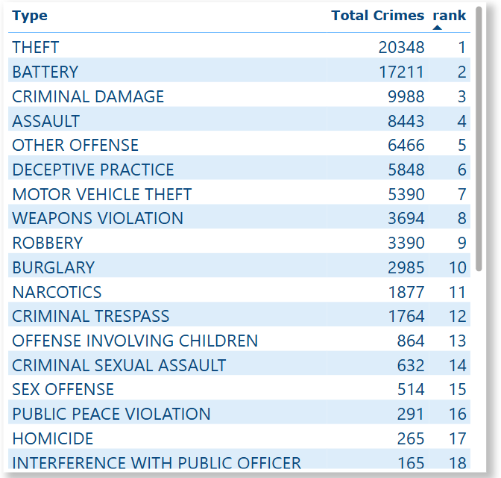
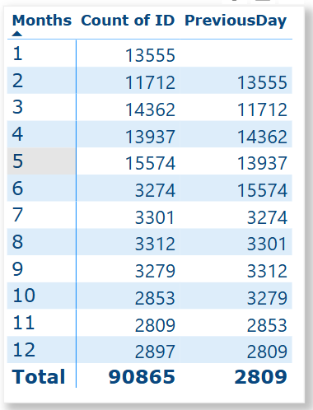
Annual Trends: Crime Type Rankings & Monthly Volume Fluctuations

Slide 13
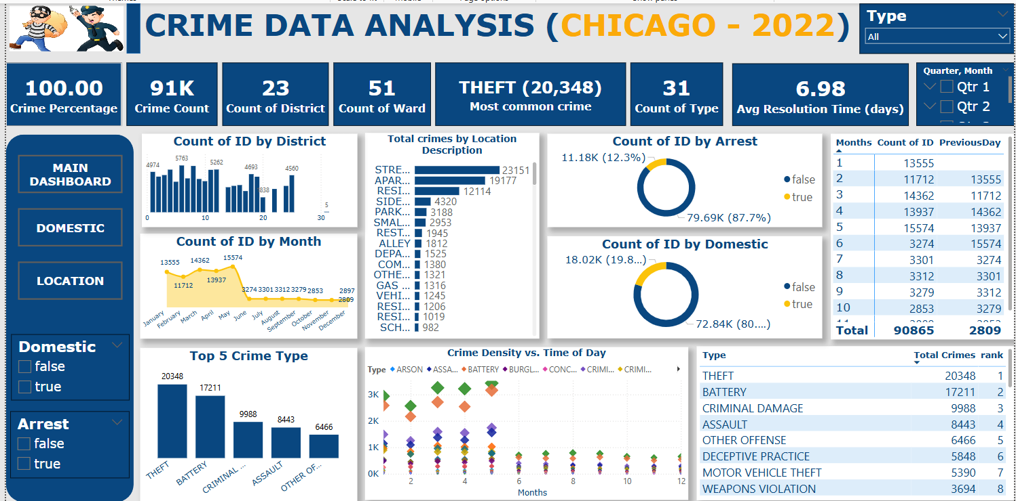
Main tab dashboard

Slide 14
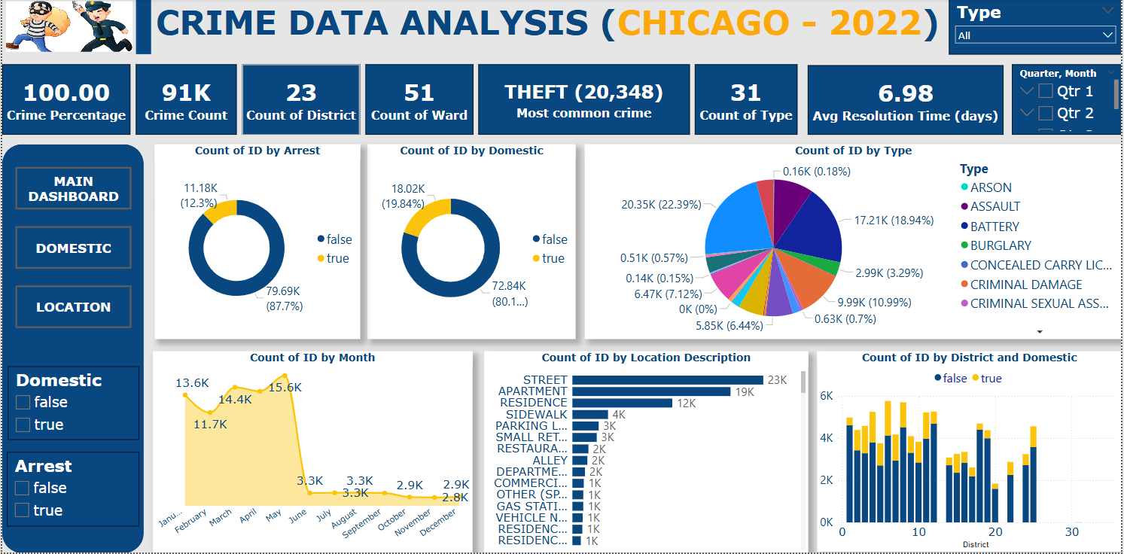
Domestic tab dashboard

Slide 15
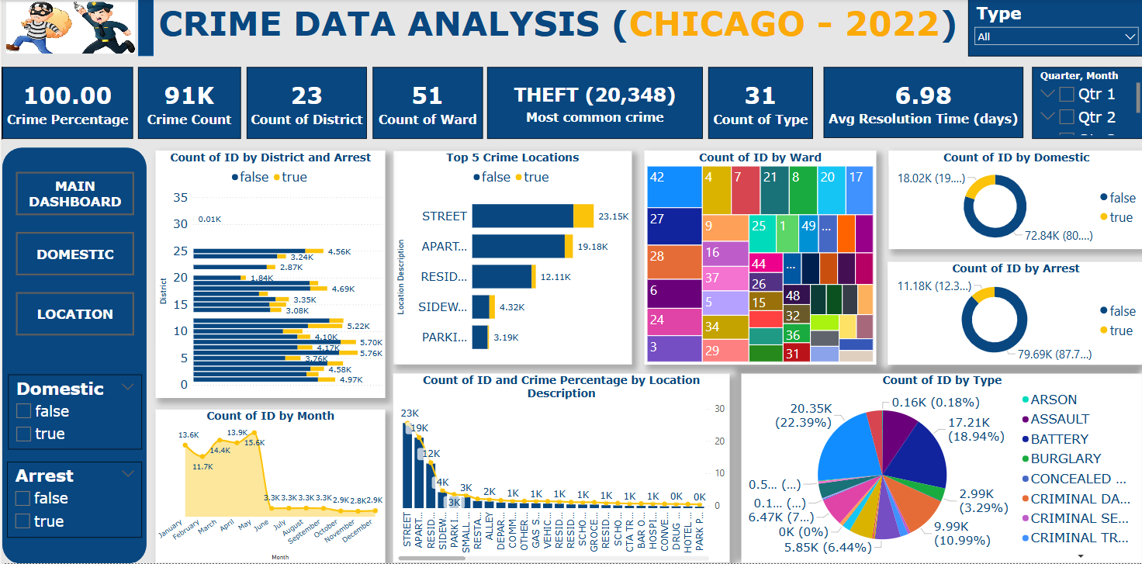
location tab dashboard

Slide 16



RECOMMENDATION
Streets, apartments, residences, sidewalks, and parking lots report the highest crime rates.
Theft, battery, and criminal damage are the most common offenses.
Recommendation: Establish a special police force focused on patrolling streets, residential areas, and parking lots. Increase accountability and regular monitoring of street patrol officers.
Strengthen Security in High-Crime Locations
Domestic crimes account for 18.02% of total crimes, but only 12.64% of offenders are arrested.
District 6 shows a disproportionately high domestic crime rate.
Recommendation: Investigate root causes in District 6 and implement support programs and stronger legal action to reduce domestic violence.
Address Domestic Crimes with Targeted Interventions
District 8: Out of 5701 crime cases, 5169 remain pending with only 532 arrests made.
This indicates a very low arrest rate.
Recommendation: Deploy special investigation officers to District 8 to analyze arrest process failures and boost enforcement efficiency.
Improve Arrest Rates in Critical Districts

